Slide 1

INVENTORY MANAGEMENT system
INFO 5100 – APPLICATION ENGINEERING AND DEVELOPMENT
FINAL PROJECT
05th MAY, 2022

Slide 2
TEAM MEMBERS
AESHA SHERATHIA - 002929942
ANVITHA LAKSHMISHA - 002765377
SAI SRUJAN PENTA - 002928427

Slide 3
INTRODUCTION
COVID and other pandemics have the potential to kill a substantial number of people.
Millions of people will be affected by pandemics or natural calamities.
The economy of a country may suffer as a result of pandemics or disasters, necessitating assistance from other countries.
It is essential at this time to assist such countries and regions.
This will restore that country/region back to life in the near future.

Slide 4
Here are 5 of the most effective ways to help disaster/pandemic victims,
Plan a fundraiser.
Send goods and supplies to the ones in affected areas.
Ship supplies into recovery and evacuation zones.
Give blood.
Donate to accredited disaster relief organizations.

Slide 5
Problem statement
We must make certain that we assist other countries in times of calamity or pandemic.
This can be made simple if there is indeed a method via which a country can request the support of its citizens or organizations to rebuild the devastated country.

Slide 6
OUR SOLUTION
Multiple countries can help each other in cases of natural disaster like earthquakes, floods etc., Pandemic or any other medical emergencies
Inventory Management System designed to assist and provide aid to numerous countries or regions when needed by monitoring supply and demand.
In the event of a pandemic, this application will take care of all medical equipment and vaccinations required in certain hospitals.
In the event of a natural disaster, many companies such as supermarket chains and textile merchants, as well as individual donors who wish to donate food or other valuable products, can do so, which will be of additional support to those in need.
We may also require transportation/ambulances to evacuate individuals in the event of floods, earthquakes, tornadoes, and other natural disasters.

Slide 7
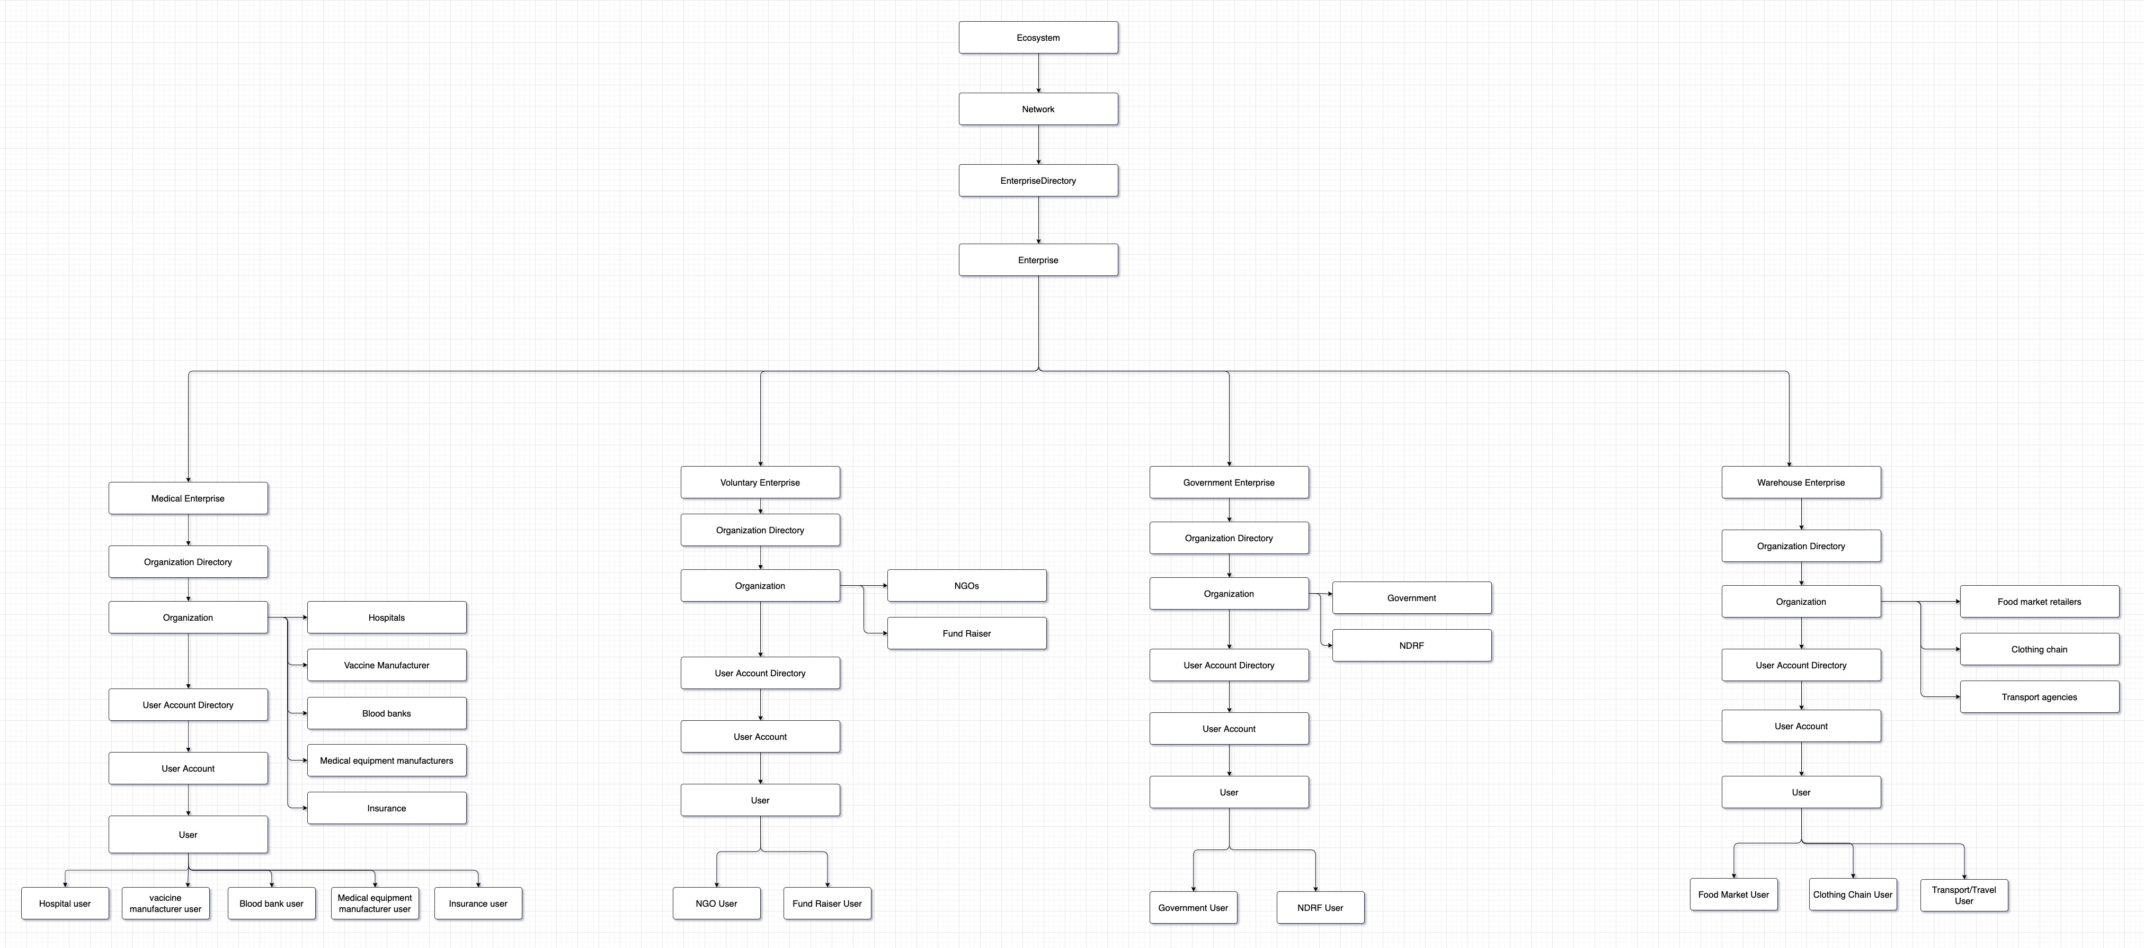
OBJECT MODEL

Slide 8
ENTERPRISES AND ORGANIZATIONS
Governments and non-governmental organizations (NGOs) can create and send requests to other organizations as needed.
Organizations can declare what they are willing to contribute as well as how much they have available.
Based on their inventory availability, organizations could approve or reject requests received from the government or admin.
It is permissible for organizations to seek assistance from other organizations.

Slide 9
We have four Enterprises,
Government
Medical
Warehousing
Voluntary
And twelve Organizations,
Government
NDRF
Hospitals
Blood Banks
Medical Equipment Manufacturers
Vaccine Manufacturers
Insurance
Food Market Retailers
Clothing Retailers
Transport Agencies
NGO’s
Fund Raisers

Slide 10
USER ROLES
USER ROLE TYPE | USER ROLE NAME
Admin Login | Admin
Food Market | Food_user
Clothing | Clothing_user
Transport | Transport_user
NGO | NGO_user
Government | Govt_user
NDRF | NDRF_user
Hospitals | Hospital_user
Vaccine Manufacturer | VM_user
Medical Equipment | ME_user
Fund Raiser | FR_user
Blood Bank | BB_user

Slide 11
USER ROLES
The Admin user has the ability to create new users, as well as approve or reject requests from organizations.
When a crisis or pandemic is reported, a government/NGO user can make a request for other organizations.
The portal provides role-based access to all organizations.
Each organization can use their login credentials to manage requests, change inventory availability, and make and submit requests for assistance to other organizations.

Slide 12
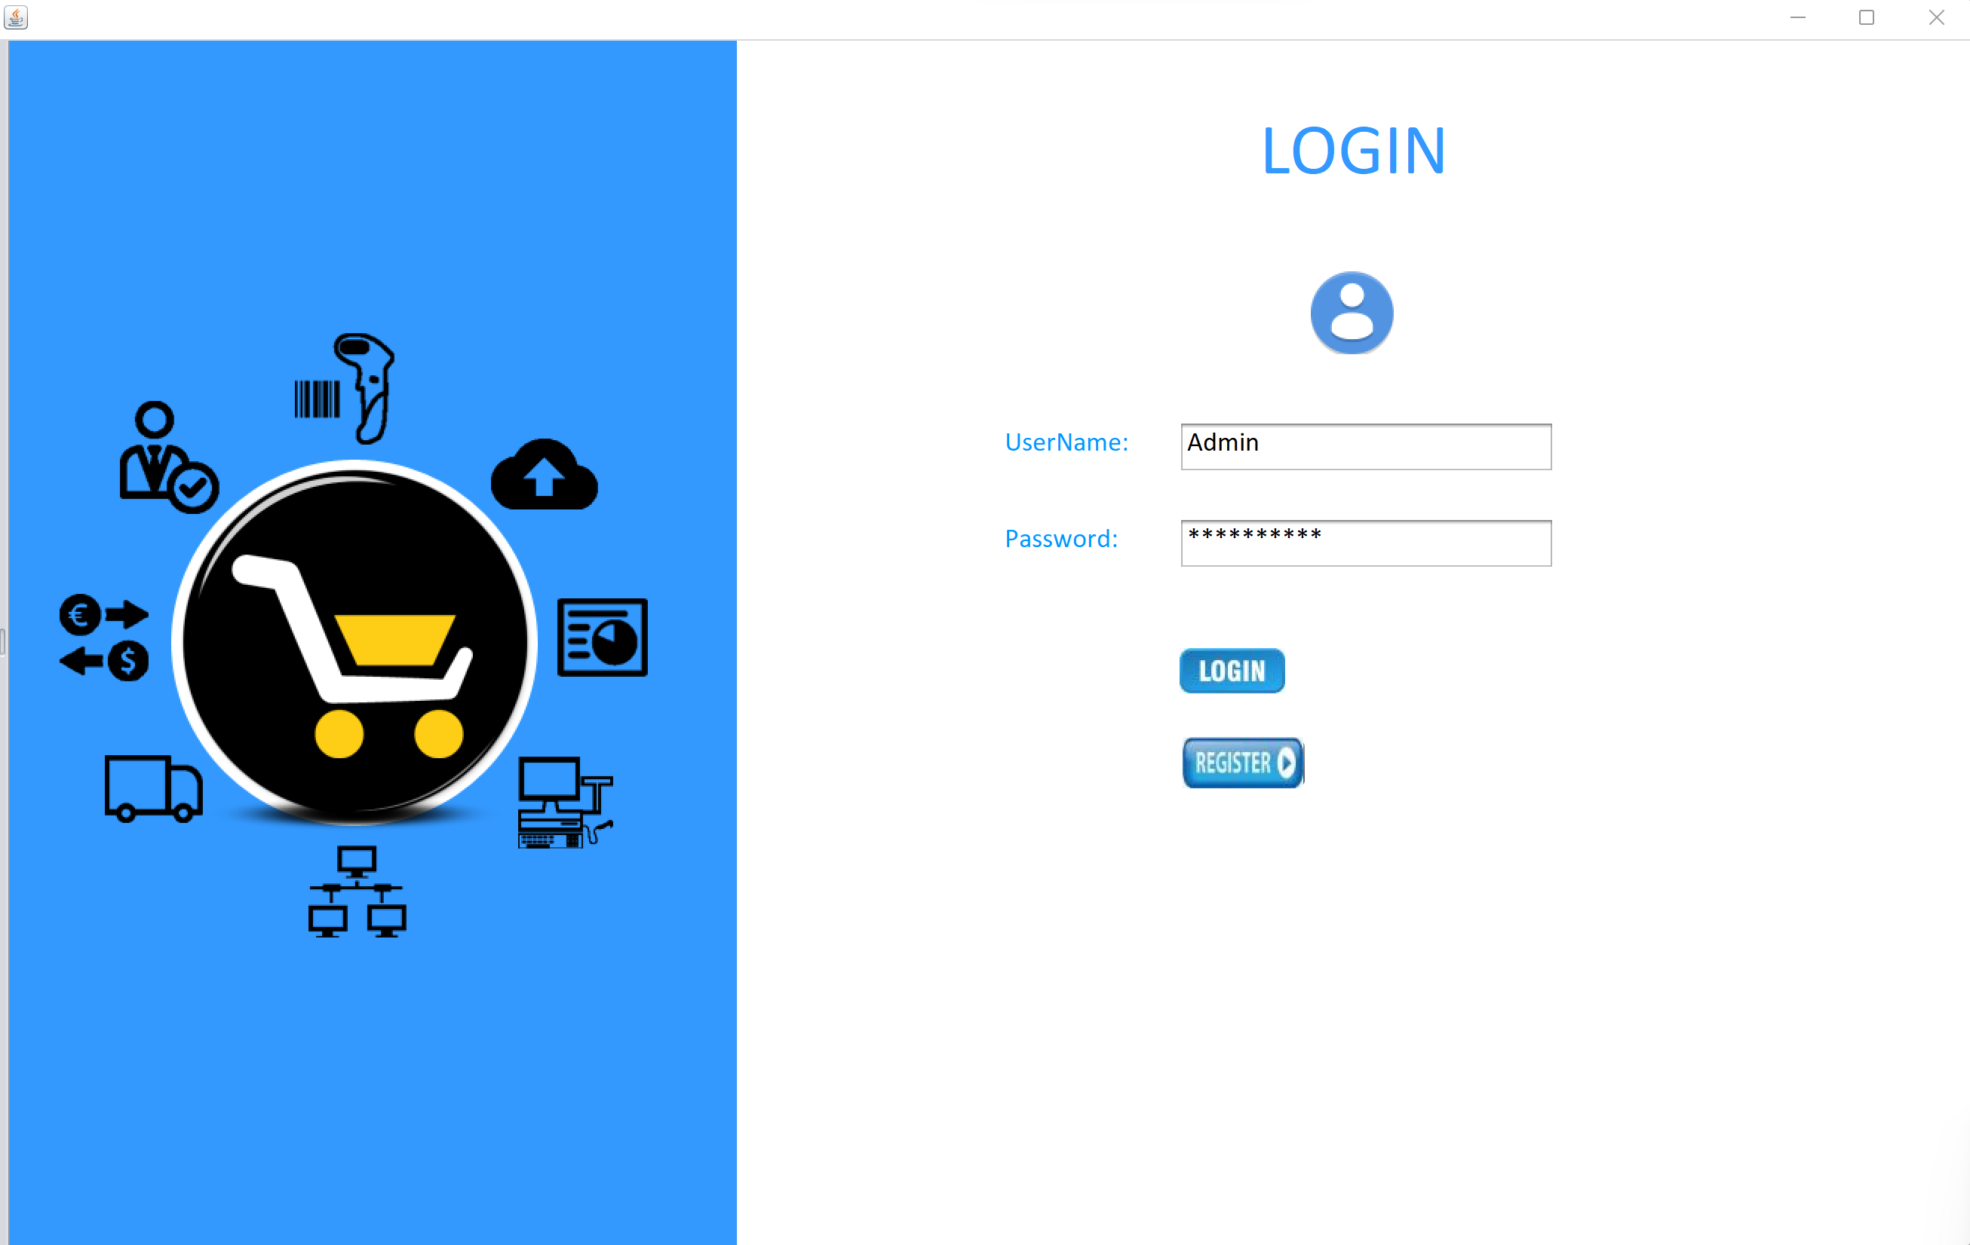
UI SCREENS
LOGIN SCREEN – User Login Credentials needs to be given in the fields and if it matches with the ones in the database, It allows user to login.

Slide 13
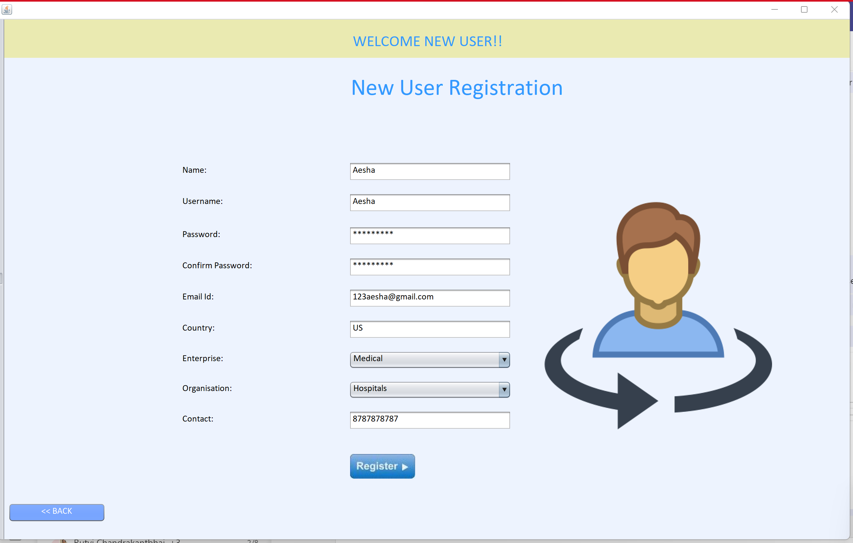
USER REGISTRATION SCREEN – A person or organization can register for an account here. A set of data needs to be given in order to register.

Slide 14
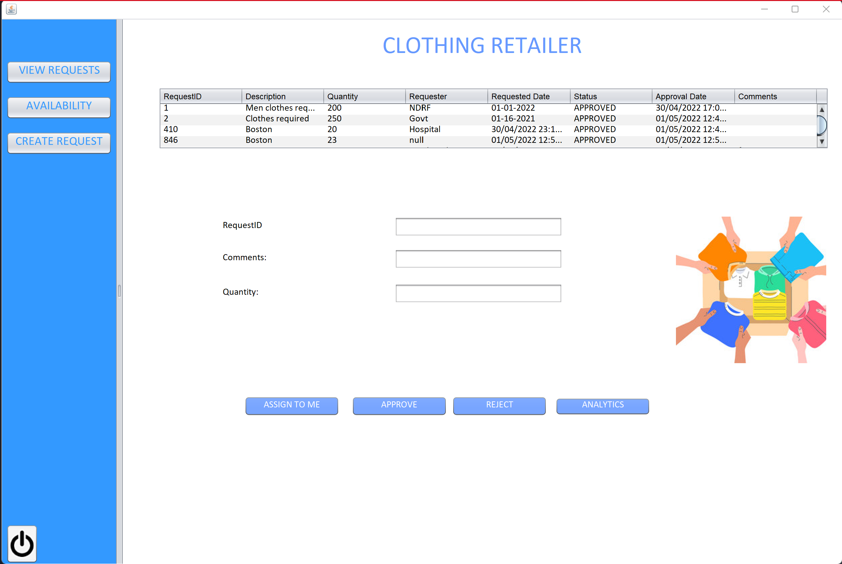
ORGANIZATION HOME SCREEN – Requests for the organization will be displayed in a table. They can either be approved or rejected according to the inventory availability.

Slide 15
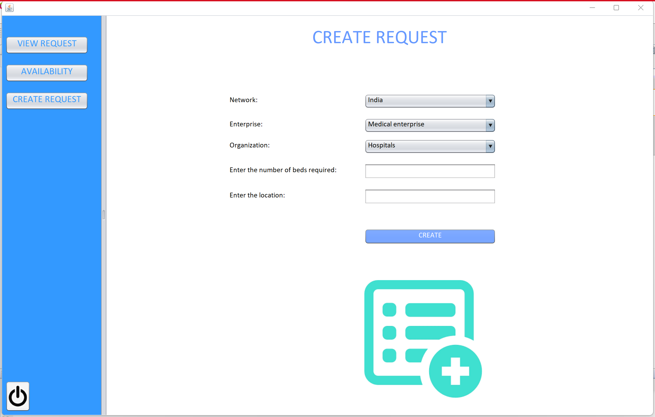
CREATE REQUEST SCREEN – A request can be created by an organization to some other organization for assistance in this screen.

Slide 16
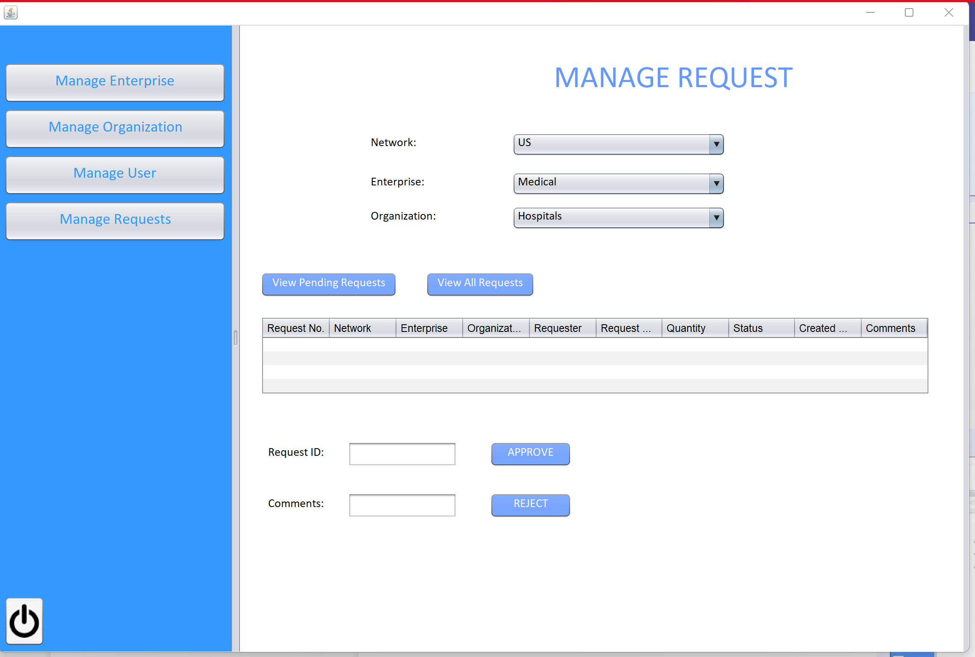
MANAGE REQUEST SCREEN – Any requests created between organizations needs to be approved by admin. Only then the organizations can see those requests.
That can be done here in Manage Requests screen by admin.

Slide 17
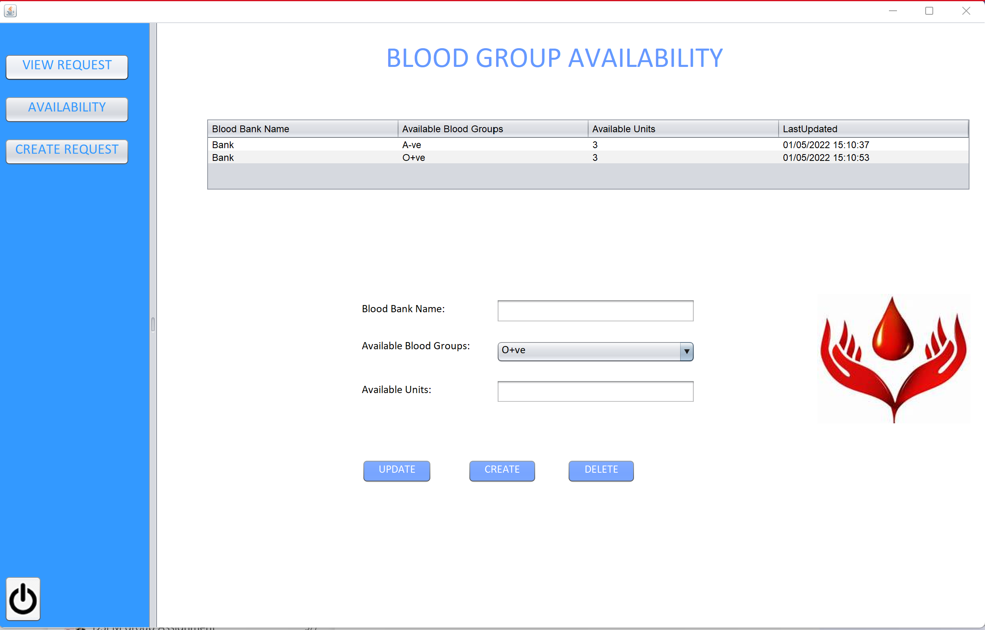
AVAILABILITY SCREEN – Organizations can update the inventory availability in the Availability screen.

Slide 18
key FEATURES - email
When a user registers in the portal, they will receive an email stating that a user has been created using their personal information.
An Email will be received when a request is created or updated by the user.

Slide 19
key features - ANALYTICS CHART
Every organization will be able to examine and understand their request metrics.
There will be a pie chart displayed.
Total Number of Requests
Number of Requests Approved
Number of Requests Rejected
Number of Pending Requests

